Slide 1

Student-centered approach: Using outcomes to guide assignment design
Carolyn Gubala, Director of Teaching, Writing Center

Slide 2
What does it mean to be student-centered?
Student centered is more than just knowing students need to get something out of what you’re teaching or that the students like an assignment.
It begins with a deep understanding of the student population, institutional affordances/constraints, departmental needs, and stakeholder expectations.
Student-centered instruction means creating an environment conducive to learning.

Slide 3
How to integrate a student-centered approach into courses?
A student-centered approach includes transparent course design and communicating to students the connections between what they are learning and the work they are doing.
This approach helps students find meaning in their work, both in terms of how it connects to their experience and how they will use what they learn moving forward.

Slide 4

Isn’t all teaching student-centered?
Yes, of course! However, this approach advocates for instructors to take a purposeful examination of teaching materials to see if classes are reaching the student learning outcomes.

Slide 5
What are
outcomes?
Student learning outcomes (SLOs)
describe the goals of the learning experience to students.
Notes:
They are not some educational babble or only for institutional assessment. They are key to aligning and directing teaching and learning.

Slide 6
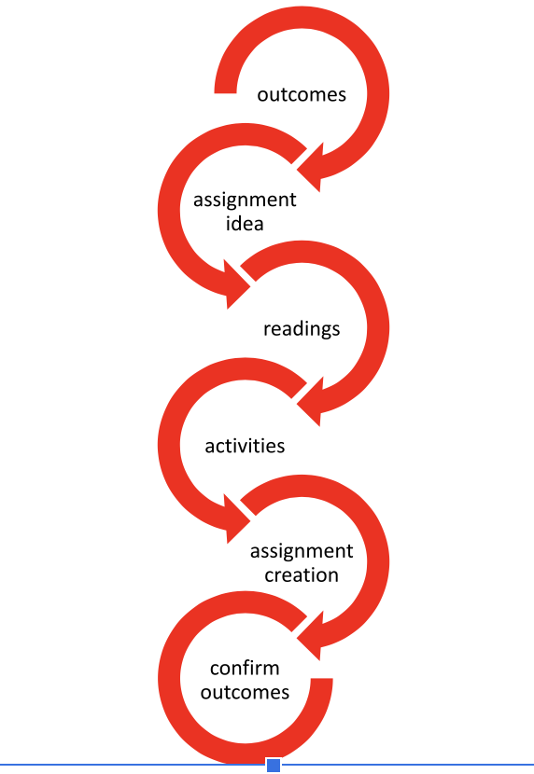
Interconnected
Notes:
Outcomes are interconnected to each step of assignment creation

Slide 7
Clear expectations
“...outcomes help to mitigate inconsistent expectations of satisfactory work by using student-focused and cultural language...to ensure students understand what is expected of them” (Montenegro & Jankowski, 2020, p. 7)
“offering students a clearer and more transparent picture of their assignments before they start can lead to better results, particularly among student populations that typically perform poorly” (Gooblar, 2019, p.86)
Notes:
refer to program inclusion audit handout

Slide 8
How to be more student-centered using outcomes?
Suggestion #1: Examine the outcomes in a class you teach
Whether you have taught a course for 20 years or are preparing it for the first time, reviewing the learning outcomes helps ensure that students achieve the intended goals and that course experiences remain consistent across instructors within a unit or department.

Slide 9
Read the outcomes and summarize the point of the outcome in 1-3 words:
Example from UWP 101:
“To help students understand the rhetorical context of all writing, both academic and professional; to provide instruction in writing for different audiences and purposes.”
This outcome is embedded or two outcomes in one. The first part is about the genre and the second part is purpose and audience.

Slide 10
Coding of the outcomes
To improve students' analytical skills in reading and writing; to explore through readings and writing assignments issues and problems both unique and common to particular disciplines and professions
  Genre: Academic & professional
To help students understand the rhetorical context of all writing, both academic and professional; to provide instruction in writing for different audiences and purposes
  Purpose and audience and genre
To give students an opportunity to explore a variety of non-fiction writing forms including narrative, analysis, explanation, argument, and critique
  Genre and modality
To adapt academic writing skills and modes of expression to the kinds of writing tasks that different professions and careers demand
  Genre and modality
To explore ways in which in variety of different research strategies (including, for example, field studies, surveys, interviews, and observations) can inform academic, literary, and professional non-fiction writing
  Research component
To help students develop a clear, lively, and forceful prose style, and to adapt that style to different writing situations and audiences
  Rhetorical awareness: Style and clarity
To encourage students to develop appropriate and consistent strategies for organizing and developing written assignments
  Writing process and revision
To provide students with principles of and experience in editing their own work and that of other student writers for content, clarity, and style
  Writing process and revision
To improve students' analytical skills in reading and writing; to explore through readings and writing assignments issues and problems both unique and common to particular disciplines and professions
To help students understand the rhetorical context of all writing, both academic and professional; to provide instruction in writing for different audiences and purposes
To give students an opportunity to explore a variety of non-fiction writing forms including narrative, analysis, explanation, argument, and critique
To adapt academic writing skills and modes of expression to the kinds of writing tasks that different professions and careers demand
To explore ways in which in variety of different research strategies (including, for example, field studies, surveys, interviews, and observations) can inform academic, literary, and professional non-fiction writing
To help students develop a clear, lively, and forceful prose style, and to adapt that style to different writing situations and audiences
To encourage students to develop appropriate and consistent strategies for organizing and developing written assignments
To provide students with principles of and experience in editing their own work and that of other student writers for content, clarity, and style

Slide 11
How to be more student-centered?
Suggestion #2: Use outcomes to guide assignments
It’s easy to lose the connection to the outcomes the longer you’ve been teaching!

Slide 12
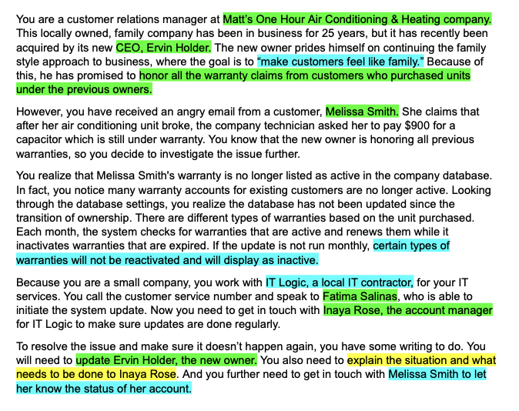
Examine your assignments for outcomes
Go through each project in your curriculum and highlight where you see each outcome in your prompts.
For example, the image on the right is highlighted to show this outcome:
Write for a specific purpose and audience

Slide 13
What can you do right now with
what we’ve talked about today?

Slide 14
Instructors
Evaluate and summarize the outcomes of the course.
Design projects based on outcomes, ensuring there is a clear connection between the outcomes and the work being assigned.
Survey Responses
Notes:
Students should be able to think through and identify the changes that will make their documents more effective. Instructors can help students develop these critically reflective skills by facilitating an understanding of the outcomes and what they mean, then fostering connections between the concepts in the outcomes and what the outcomes look like in students’ writing.

Slide 15
Program
Administrators
Offer Professional Development
Perform Ongoing Program Evaluation

Slide 16
Citations
Gooblar, David. (2019). The missing course: Everything they never taught you about college teaching. Harvard University Press.
Montenegro, Erick, & Jankowski, Natasha. (2020). A new decade for assessment: Embedding equity into assessment praxis. National Institute for Learning Outcomes Assessment. https://www.learningoutcomesassessment.org/wp-content/uploads/2020/01/A-New-Decade-for-Assessment.pdf

Slide 17
Thank you!
Please email or reach out with any feedback or questions:
cmgubala@ucdavis.edu

