Slide 1



Exam Wrappers for Reflection and Growth
SITT 2026
Whitney C. Duim
Assistant Professor of Teaching
wcduim@ucdavis.edu

Slide 2
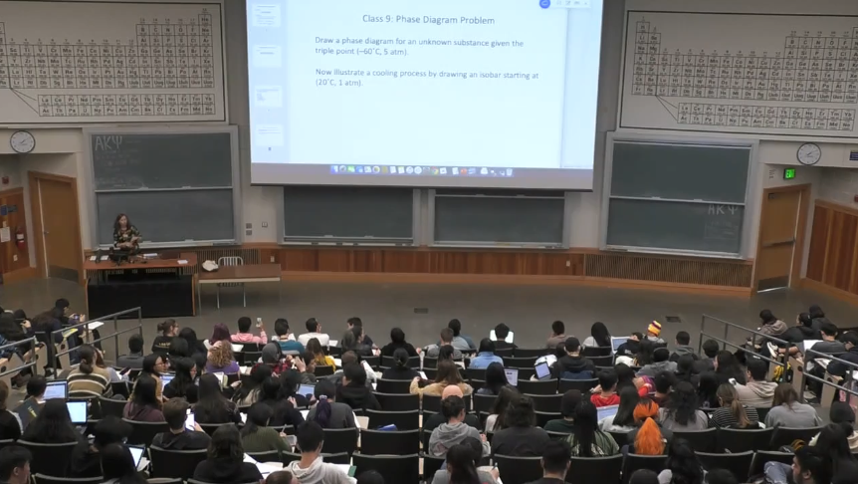
Classes I teach
General Chemistry
Physical Chemistry for the Life Sciences
Principles of Medicinal Chemistry
Analytical & Physical Chemical Methods
First-Year Seminars CURE
With students 1st to 4th years, 50-450/class, transfer students…
2

Slide 3
Goals
Support the adoption of a growth mindset
Motivate students to keep practicing and use mistakes as learning opportunities
Normalize the challenge of learning difficult concepts and making mistakes
  Messaging
Classroom practices
  Educational technology
3

Slide 4
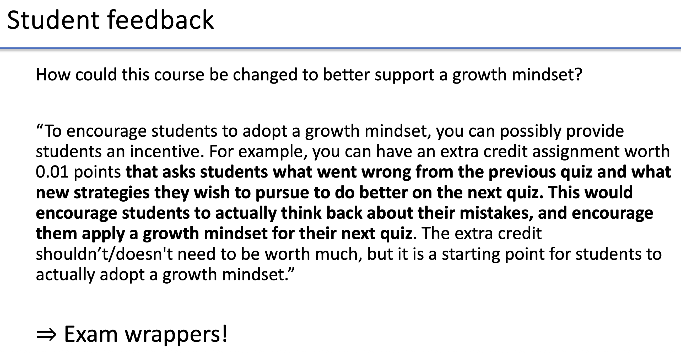
Fostering a growth mindset with educational technology, classroom practices, and consistent messaging
Two years ago…
SITT 2024
4
Whitney Duim, UC Davis

Slide 5

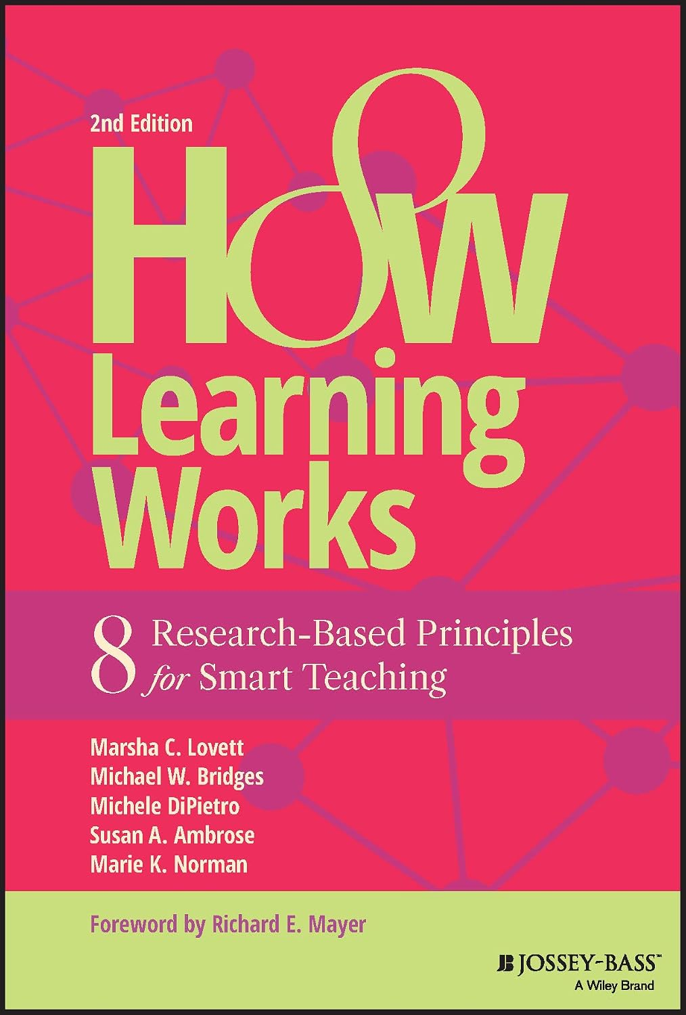
Exam wrappers
Activity: students reflect on exam performance
and effectiveness of exam preparation
Exam wrapper adapted from:
(1) Lovett, M. C., et al. (2023). How learning works: Eight research-based principles for smart teaching. John Wiley & Sons, Inc.
(2) Lovett, M. C. (2013). Make exams worth more than the grade: Using exam wrappers to promote metacognition. In M. Kaplan, et al. (Eds.), Using reflection and metacognition to improve student learning: Across the disciplines, across the academy (pp. 18-52). Sterling, VA: Stylus.
5

Slide 6
Why use exam wrappers?
Motivate students to look more carefully at their exam preparation and performance, and also at the exam answer key.
(2) Guide students to identify preparation strategies that will help them to perform well on exams and that are an efficient use of their limited time, and identify (and stop) preparation strategies that are not helpful and are inefficient uses of their time.
(3) Support the adoption of a growth mindset by students.
6

Slide 7
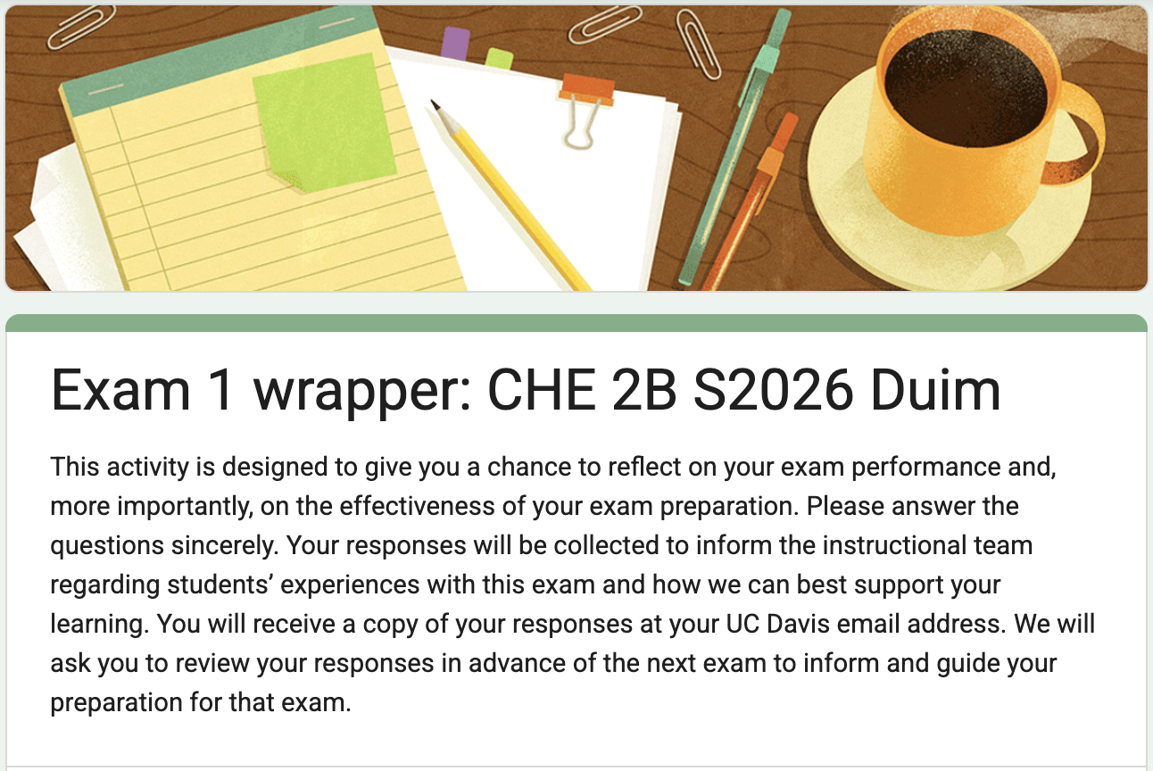
Implementation
Physical Chemistry CHE 107A F2024:
Quiz 2
General Chemistry CHE 2B W2025, S2025,
S2026: Exam 1
Google Forms
Incentive: students received 2 points added onto their Exam 1 score (+3%)
I briefly reviewed common responses with students in class
7

Slide 8
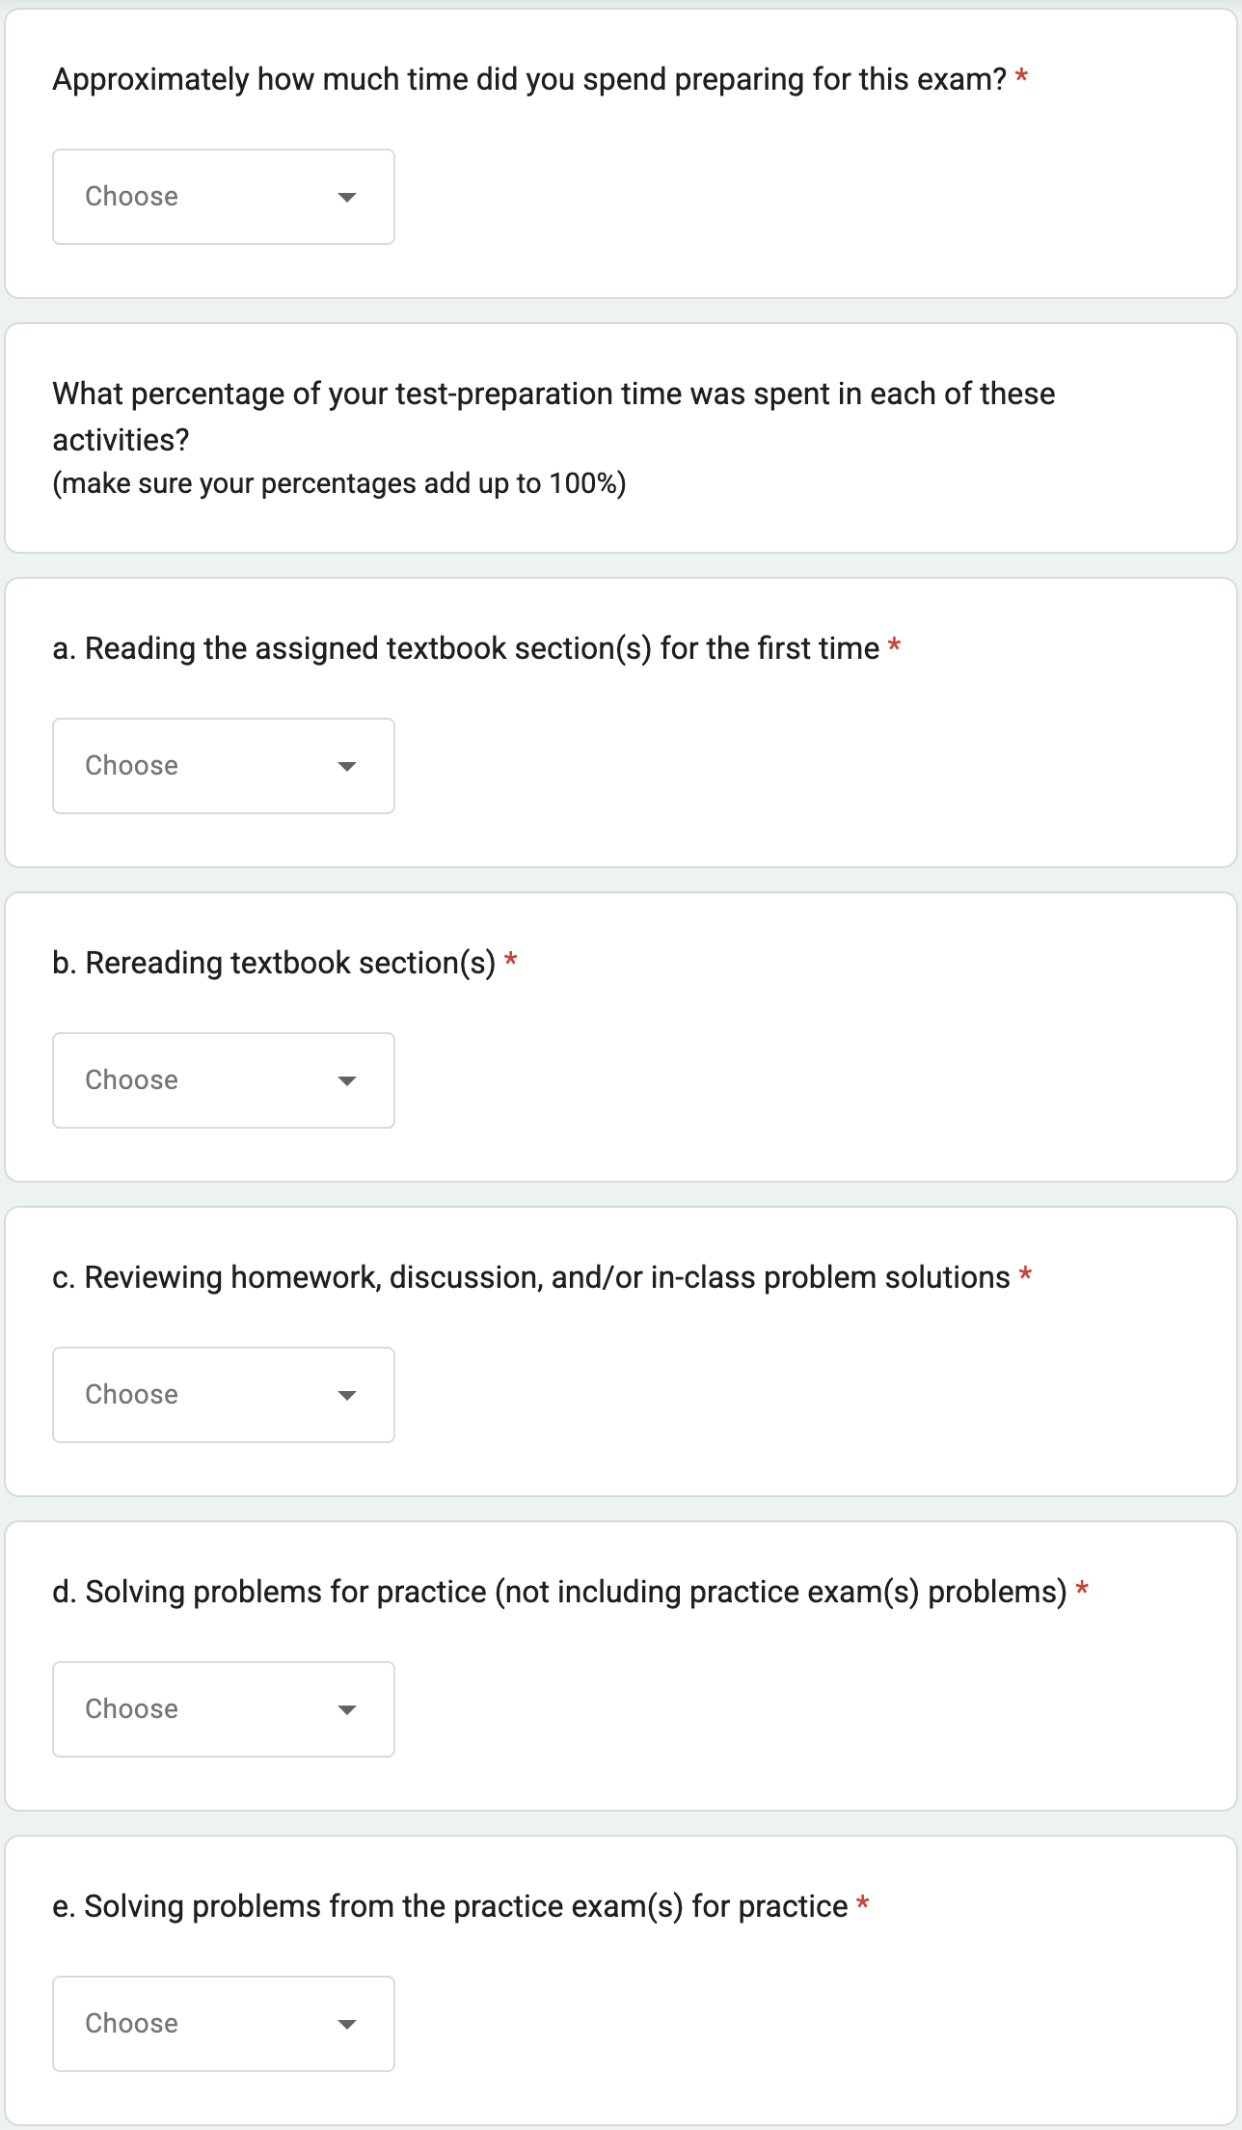
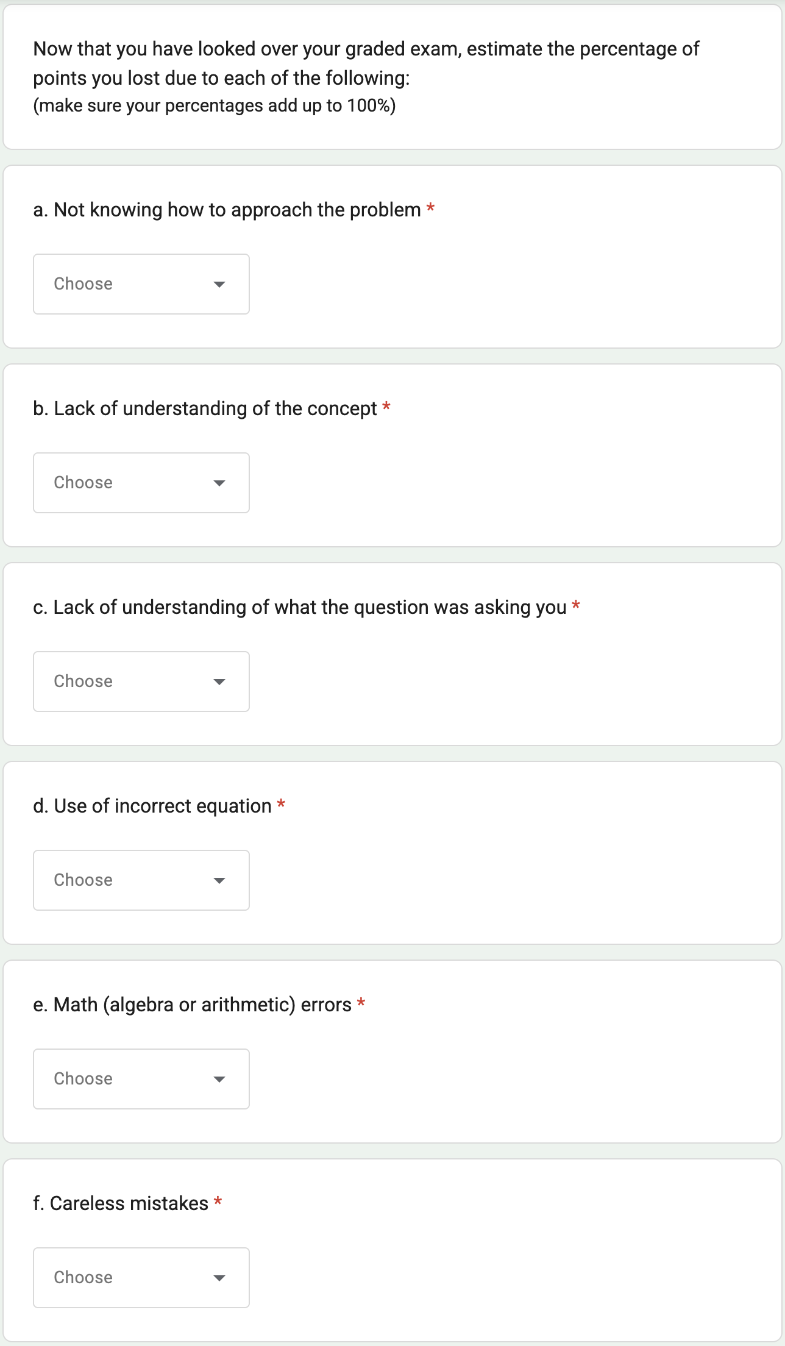
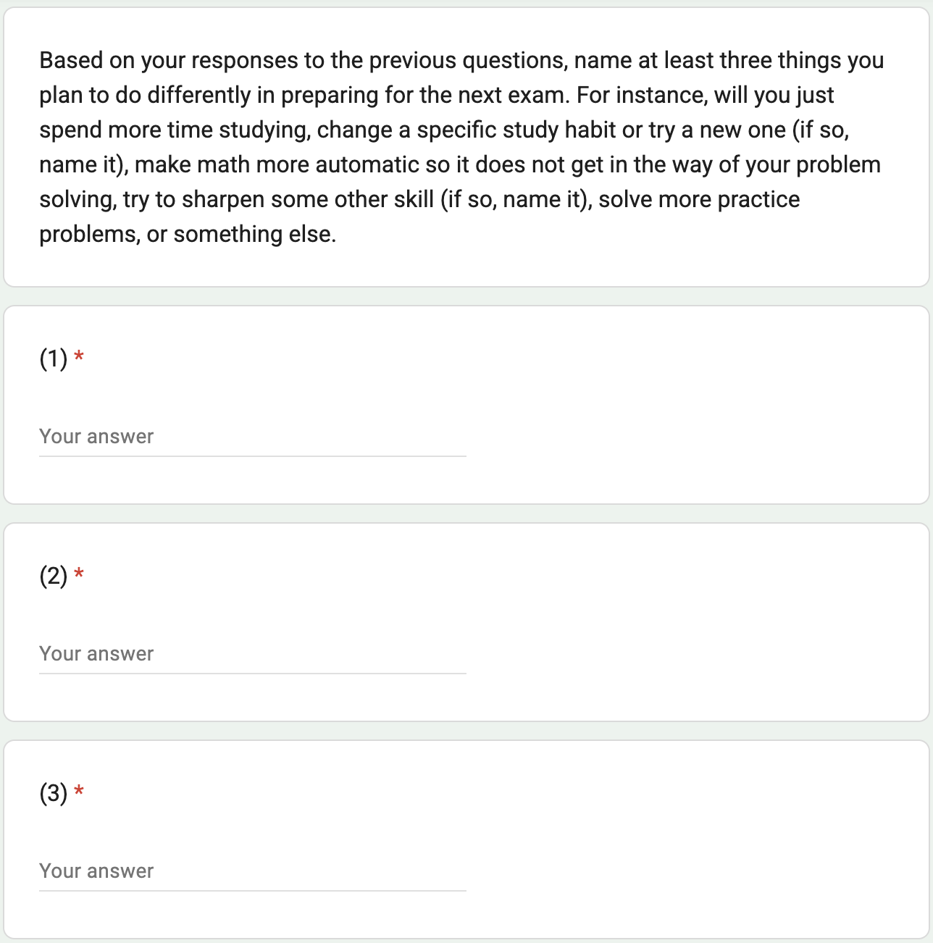
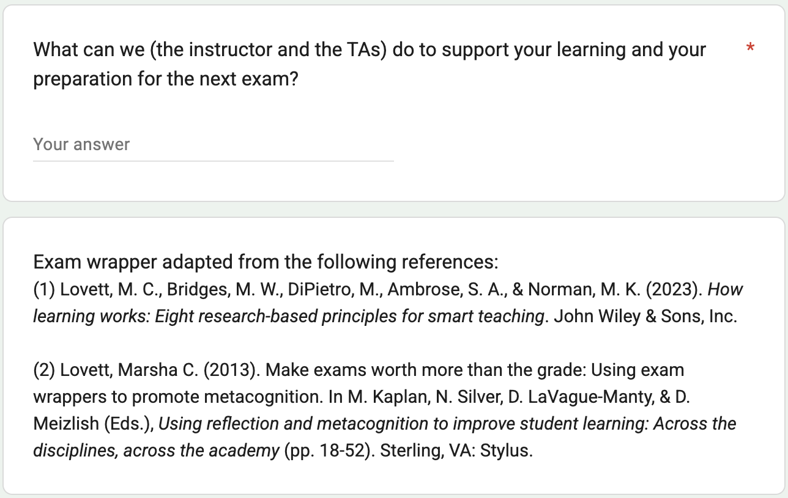
Google form exam wrapper
A copy of your responses will be emailed to youremail@ucdavis.edu.

Slide 9
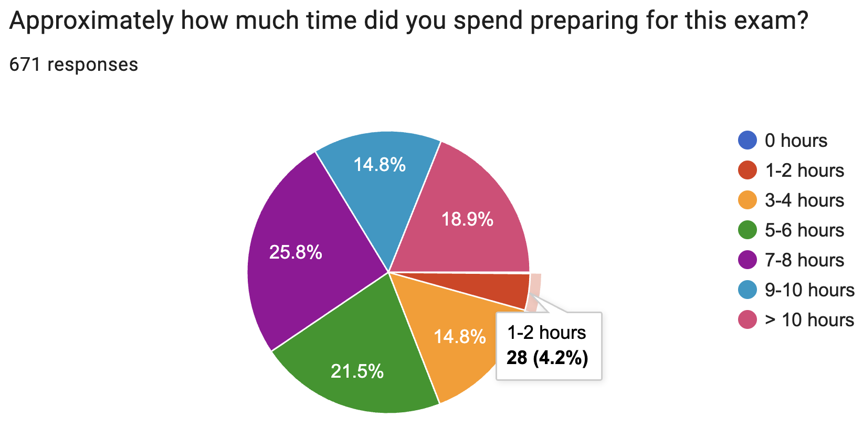
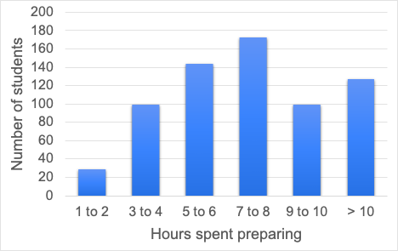
Responses
General Chemistry (CHE 2B)
2 sections, spring 2026
671 students responded (out of 902 total)
Approximately how much time did you spend preparing for this exam?
9

Slide 10
What percentage of your test-preparation time was spent in each of these activities?
(make sure your percentages add up to 100%)
 | Mean | Median | Mode
Reading the assigned textbook section(s) for the first time | 7% | 0% | 0%
Rereading textbook section(s) | 4% | 0% | 0%
Reviewing homework, discussion, and/or in-class problem solutions | 29% | 20% | 20%
Solving problems for practice (not including practice exam(s) problems) | 22% | 20% | 10%
Solving problems from the practice exam(s) for practice | 32% | 30% | 20%
Reviewing course lecture slides | 12% | 10% | 0%
Reviewing your own notes (from lecture, from reading the textbook, from discussion sections, etc.) | 16% | 10% | 10%
Watching lecture capture video(s) for the first time | 6% | 0% | 0%
Rewatching lecture capture video(s) | 5% | 0% | 0%
Reviewing and discussing material with a study group | 6% | 0% | 0%
Asking instructor and/or TAs questions during office hours | 3% | 0% | 0%
10

Slide 11
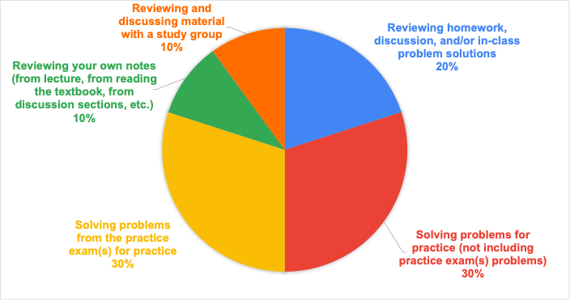
Typical student test preparation time
11

Slide 12
What percentage of your test-preparation time was spent in each of these activities?
Other (please specify activity and percent)
~40 students entered a substantive response (not including NA, none, etc.)
AI summary:
Solving practice problems (some from other sources)
Watching YouTube videos on course concepts
AATC activities: attending the co-class, workshops, receiving tutoring (individual or drop-in)
ChatGTP assistance
12

Slide 13
Now that you have looked over your graded exam, estimate the percentage of points you lost due to each of the following:
(make sure your percentages add up to 100%)
 | Mean | Median | Mode
Not knowing how to approach the problem | 19% | 10% | 0%
Lack of understanding of the concept | 17% | 10% | 0%
Lack of understanding of what the question was asking you | 12% | 10% | 0%
Use of incorrect equation | 13% | 10% | 0%
Math (algebra or arithmetic) errors | 18% | 10% | 0%
Careless mistakes | 26% | 20% | 0%
13

Slide 14
Now that you have looked over your graded exam, estimate the percentage of points you lost due to each of the following:
Other (please specify activity and percent)
~70 students entered a substantive response (not including NA, none, etc.)
AI summary:
Time management/running out of time (citing 20% to 90% of points lost)
Units and unit conversions
Significant figures
Careless calculation or reading errors
Stress, anxiety, and loss of confidence during exams
14

Slide 15
Based on your responses to the previous questions, name at least three things you plan to do differently in preparing for the next exam. For instance, will you just spend more time studying, change a specific study habit or try a new one (if so, name it), make math more automatic so it does not get in the way of your problem solving, try to sharpen some other skill (if so, name it), solve more practice problems, or something else.
AI Overall Summary:
More and earlier practice, especially with exam-style questions.
Stronger conceptual understanding, not just memorizing procedures.
Better use of available resources, including office hours, study groups, textbook materials, and lecture recordings.
15

Slide 16
Based on your responses to the previous questions, name at least three things you plan to do differently in preparing for the next exam.
AI Key Themes:
Do More Practice Problems (Most Common)
Start Studying Earlier / Avoid Cramming
Improve Conceptual Understanding
Use More Resources (OH, TAs, tutoring/AATC, etc.)
Study groups and collaboration
Timed practice and time management
Reduce careless errors
Focus on equations
Read the textbook more
Wellness and exam readiness (prioritize sleep, reduce stress and anxiety, limit technology distractions while in class/studying)
16

Slide 17
What can we (the instructor and the TAs) do to support your learning and your preparation for the next exam?
AI Overall Summary:
More practice exams and exam-style questions.
More review sessions (especially before exams).
More step-by-step explanations of difficult problems and concepts.
Better guidance on equation selection, common mistakes, and conceptual understanding.
At the same time, a large proportion of students felt that the instructional team is already doing an excellent job and that their own study habits were the primary factor affecting their performance.
17

Slide 18
What can we (the instructor and the TAs) do to support your learning and your preparation for the next exam?
AI Key Themes:
More Practice Exams and Practice Problems (Most Common Request)
Review Sessions and Study Events
More Worked Examples and Explanations
Discussion Section Improvements (TAs run discussion sections)
More Guidance on Concepts and Equations
Better Access to Resources
Exam Information and Study Guides (students want to know what to prioritize studying)
Positive Feedback (Very Common): students satisfied with instructional support and resources
18

Slide 19
Student feedback
Positive!
Incentive of points is key
From 2B course evaluation: “something that you should keep in the future courses: class pacing + 3 midterms course structure + PhET stimulations + resources on the Canvas page + exam wrapper extra credit + the enthusiasm and positivity that you always bring to the class :)”
19

Slide 20
Conclusions and next steps
Student preparation responses aligned with instructor recommendations
Valuable: where mistakes were made, careless mistakes and time management common themes, plans for more effective studying for next exam
Next:
Add exam wrappers after exams 2 and 3, look for changes and patterns
Add questions about student perceptions of their performance on the exam and in the course
Communicate common themes and emerging trends to students
Add surveys on student opinions and attitudes towards exam wrappers
Contact me wcduim@ucdavis.edu if you would like a copy of the google form!
20

Slide 21
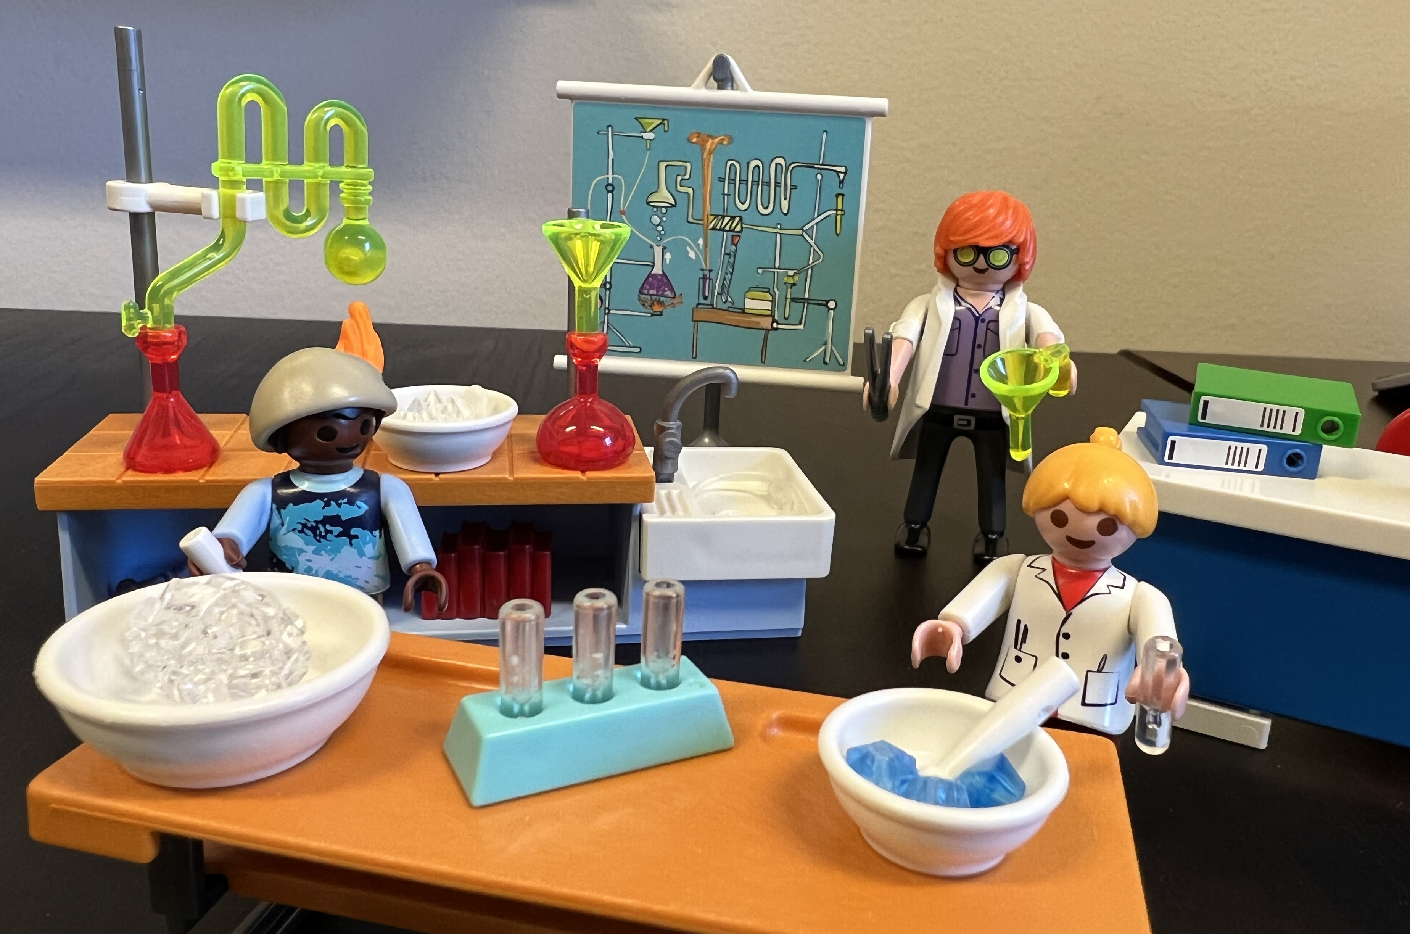
Acknowledgments
2024 Engaged Learning and Teaching Community with Katie Healey
UC Davis Center for Educational Effectiveness
SITT 2026 Organizers
Academic Technology Services
DOLCE and Faculty Forums
Colleagues at UC Davis
Microsoft Copilot, ChatGPT
Thank you!
21

